Slide 1

ACTIVISM + ANALYSIS 4 COMMUNITY HEALTH EQUITY A collaboration between Proviso Partners for Health (PP4H) and the Cook County Department of Public Health (CCDPH)
C. Scott Smith, PhD AICP (CCDPH)
Lena Hatchett, PhD (PP4H)
Notes:
This project lists the

Slide 2
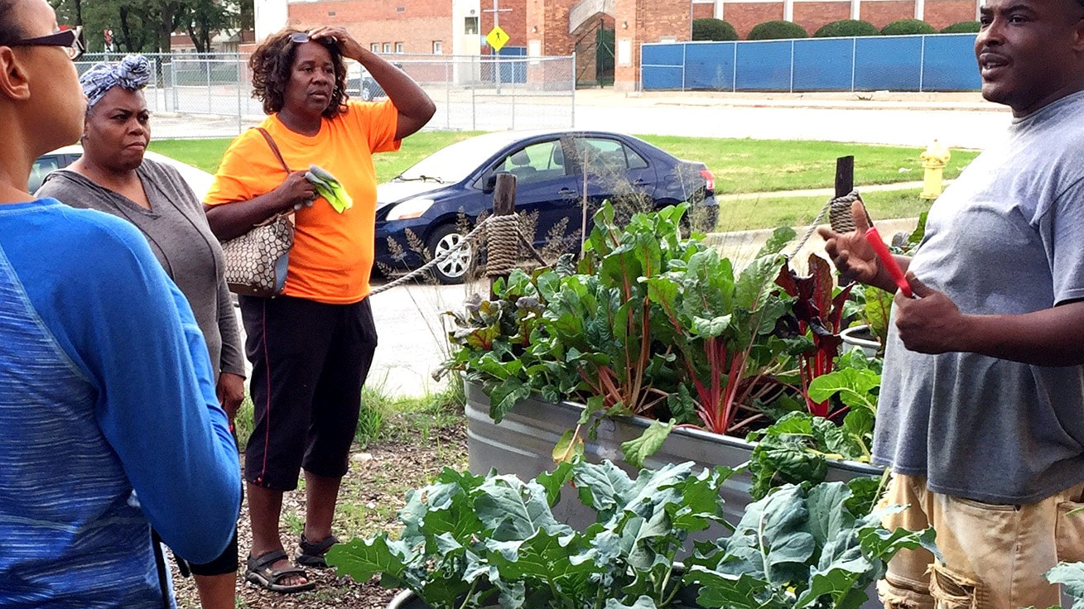
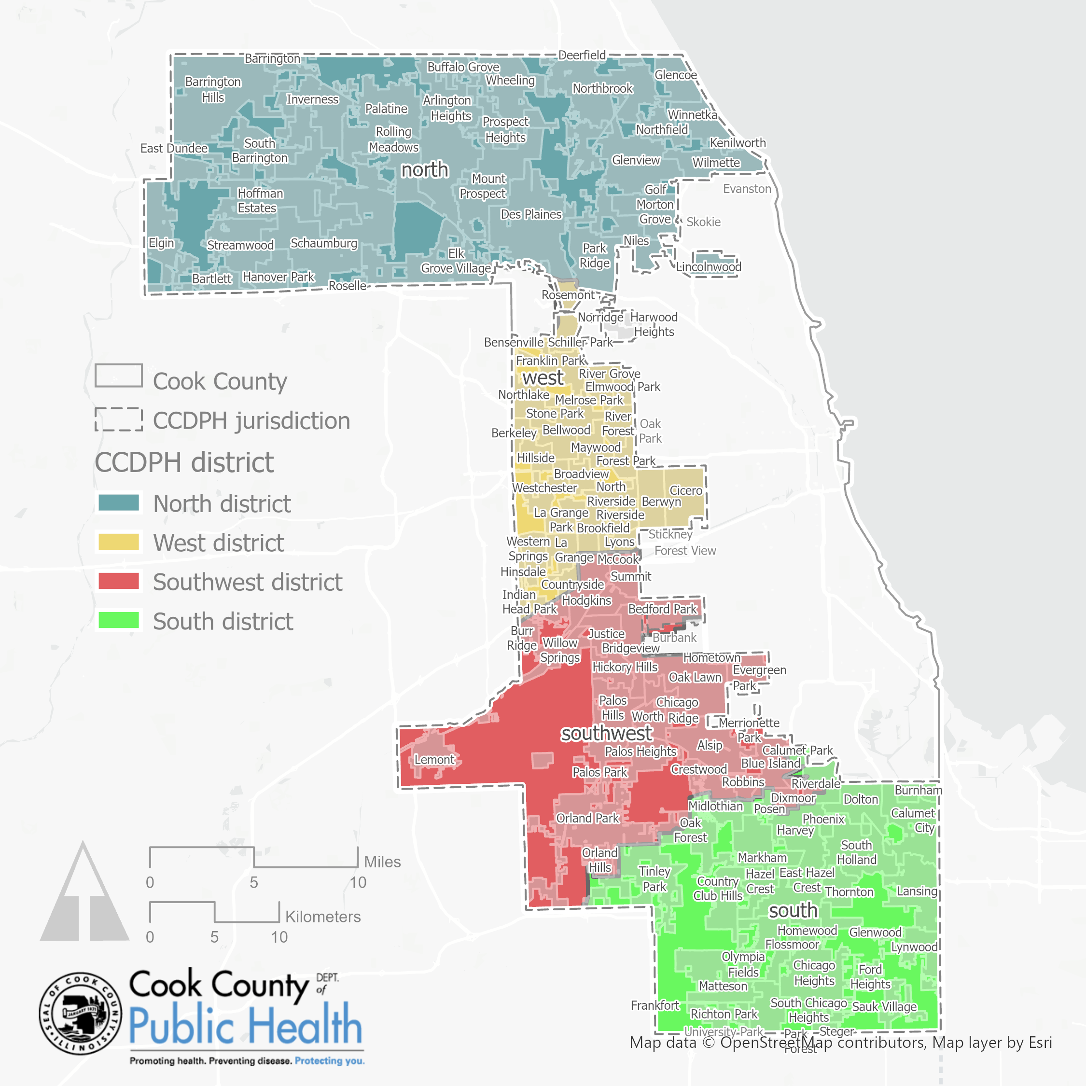
BRIDGING MISSIONS & PLACES
CCDPH
To optimize health and achieve health equity for all people and communities in suburban Cook County…
Chicago
PP4H
To build capacity and address racial, health, and economic inequities through partnerships while leveraging community assets and wisdom…
Data sources: US Census Bureau American Community Survey, 2015-2019 Table B17001, Poverty Status in the Past 12 Months by Sex by Age; TIGER/Line shapefiles, 2019

Slide 3
COMPLEMENTARY APPROACHES AND CAPACITIES
CCDPH
PP4H
Employs a network approach that brings together residents, partners and resources to address issues facing communities.
Because of all the epidemiological information CCDPG gathers and analyzes, it is a major source of information about the priority health needs throughout suburban Cook County.
This information helps partners and the public, plan for and address emerging health threats, and promote healthy living through awareness, education, programs and community development.
Works collaboratively to implement policy, systems, and environmental change strategies that promote racial, social, and economic equity within Proviso Township.
Transforms communities through shared leadership and power, innovation and social enterprise and leveraging resources and assets.
Envisions a community that encourages and supports healthy eating, active living, and economic opportunity where we live, work and play.
Notes:
wisdom/voices/power; not “competencies”; capacities

Slide 4
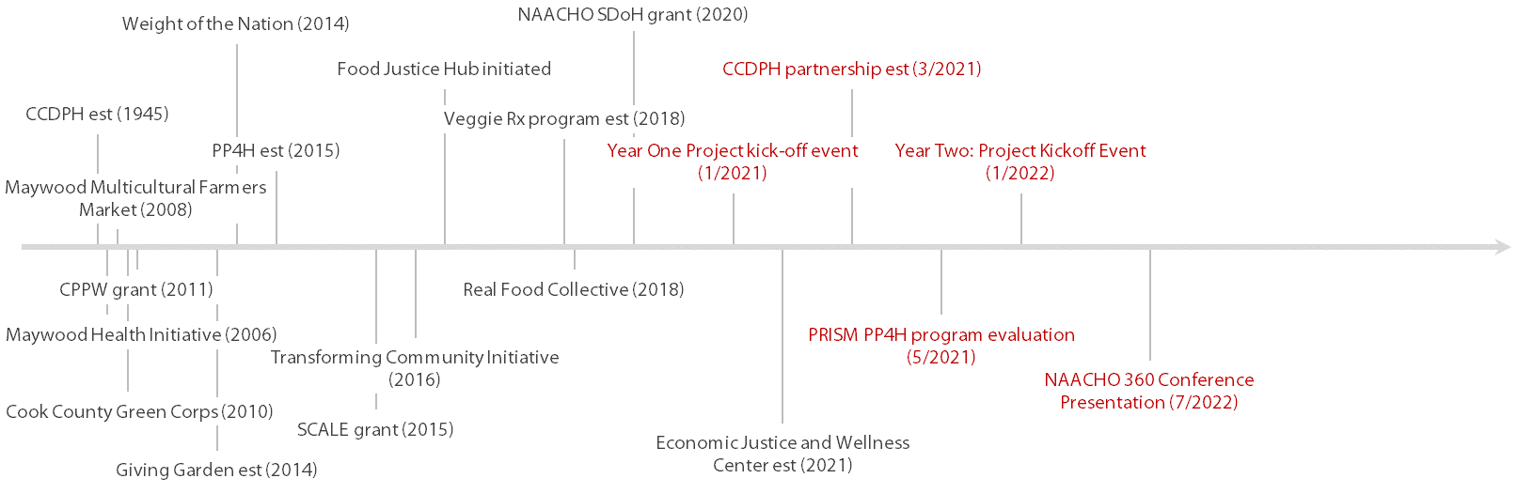
PROJECT BACKGROUND/TIMELINE
Notes:
Long history between the two organizations
Long-term Collaboratorsex
Add Cppw grant (2011)
Greencorps grant (2010)
Weight of the nation grant (201X)
“PP4H would not have been possible without Cook County”
Cook County in a process of transformation through these different novel partnerships
What we’ve grown into is movement building
movements: Food justice; economic justice; mental health

Slide 5

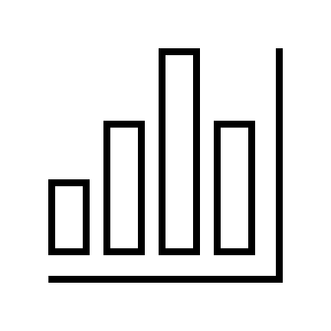

Training and technical assistance
CCDPH provided three types of training and technical assistance.
01
02
03
DATA PROCESSING
DATA ANALYSIS
DATA VISUALIZATION
Cleaning, standardizing and formatting partner program and activity data for PRISM analysis
Entering data into PRISM spreadsheet templates and web application for evaluating program/activity impact
Mapping of project-relevant health outcome prevalence and other SDOH data to further contextualize results

Slide 6
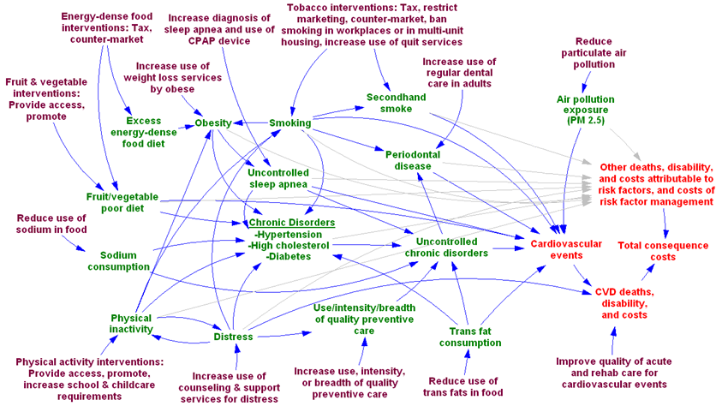

Prism framework
Notes:
Mapping the movement between intervention and impact
Touching the lives of individuals
Understanding impact is important

Slide 7
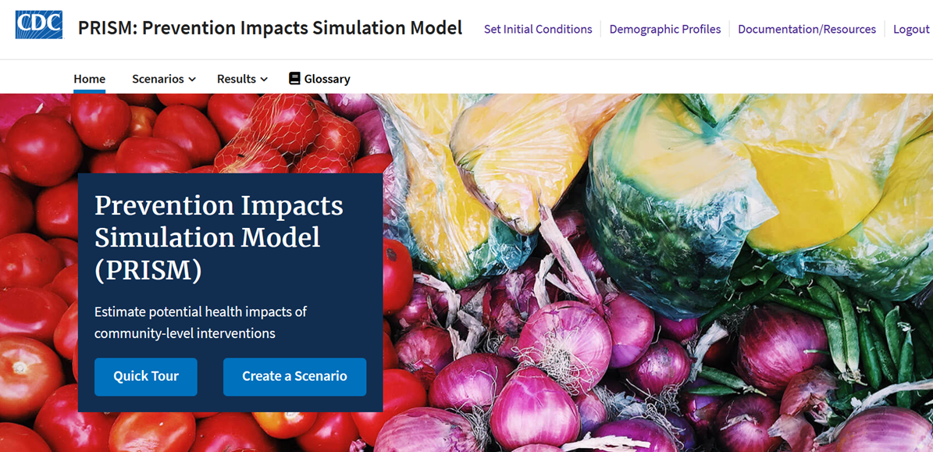
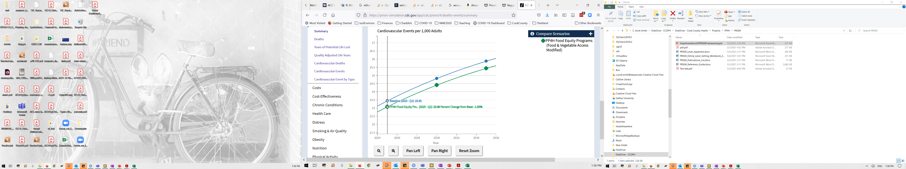
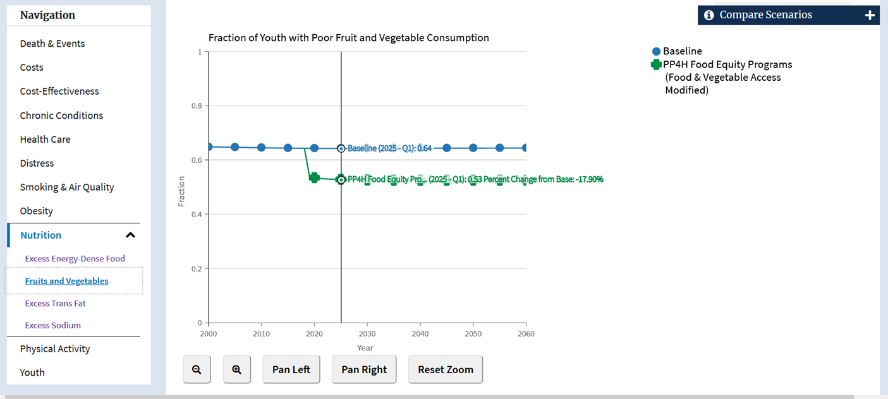
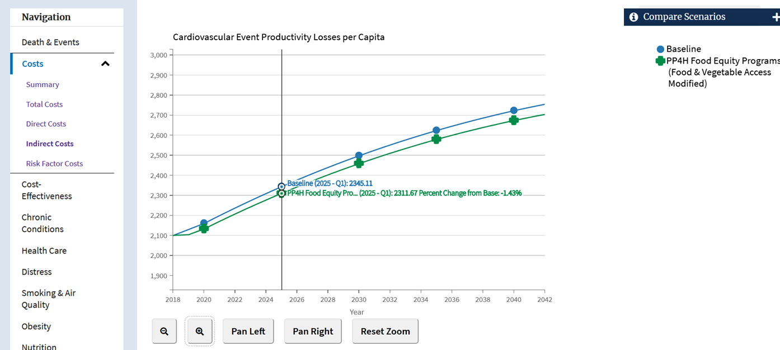
Prism SIMULATIONS

Slide 8
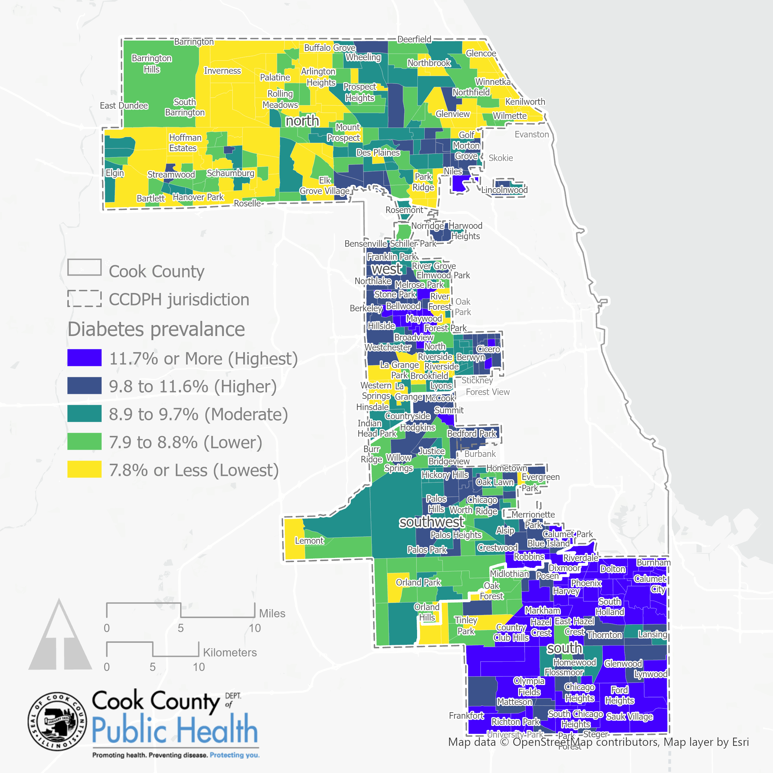
Diabetes Prevalence Estimates
This figure shows diabetes prevalence by census tract using modeled estimates from the CDC’s PLACES dataset (2020).
Areas represented in dark blue indicate communities experiencing higher levels of inequity.
Data sources: CDC PLACES, 2020; TIGER/Line shapefiles, 2019

Slide 9
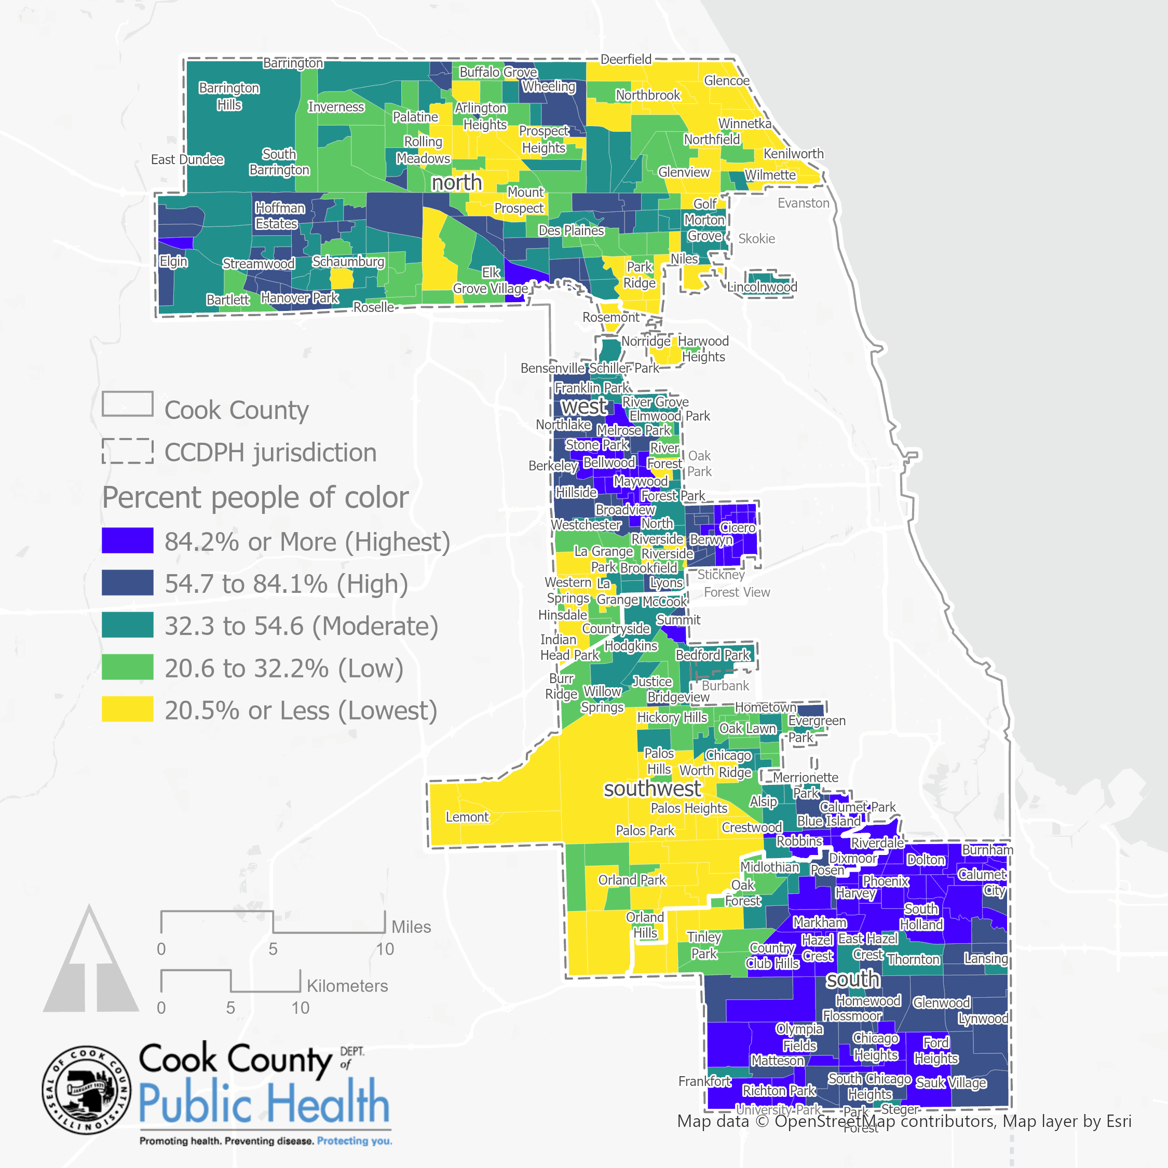
PEOPLE OF COLOR by census tract
CCDPH ‘s jurisdiction is becoming more racially and ethnically diverse:
People of color (48.3%)
Latinx (22.0%)
Asian (7.6%)
Black , not Latinx (16.8%),
White, not Latinx (51.7%)
CCDPH ‘s jurisdiction is also residentially segregated across neighborhoods and districts. Percentage of people of color by CCDPH district.
South (70.7%)
West (58.7%)
North (36.9%)
Southwest (33.5%)
Data sources: US Census Bureau American Community Survey, 2015-2019 Table B03002, Hispanic or Latino Origin by Race; TIGER/Line shapefiles, 2019

Slide 10
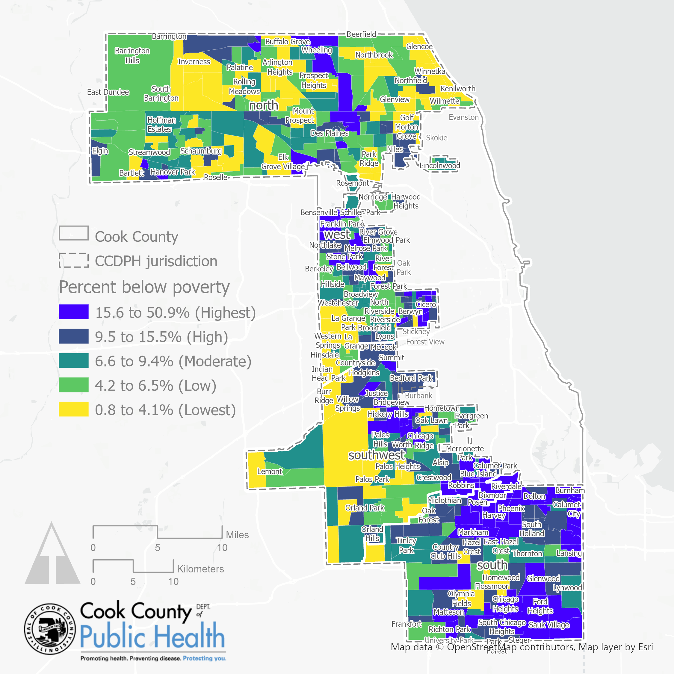
Poverty rate by census tract
The US Census Bureau set the 2019 poverty threshold for a family of four at $26,172 .
Approximately 14.4% of the population in Cook County earned below the poverty threshold in 2019 and 10.0% within CCDPH’s jurisdiction.
Poverty rates vary geographically. Below are rates by CCDPH district ordered from highest to lowest:
South (15.6%),
West (10.5%)
Southwest (10.4%)
North (6.7%)
Data sources: US Census Bureau American Community Survey, 2015-2019 Table B17001, Poverty Status in the Past 12 Months by Sex by Age; TIGER/Line shapefiles, 2019

Slide 11
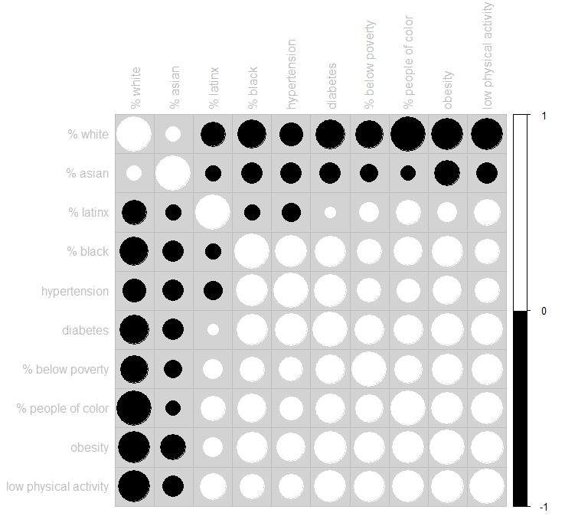
Measuring DISPARITIES
Statistical relationships exist between race, ethnicity, income and health outcomes.
Percentage of people of color is positively correlated with prevalence of hypertension, obesity and low recreational physical activity. Whereas percentage white, not Latinx tends to be strongly negatively correlated with these variables.
Poverty rates also tend to be highly correlated with poor health outcomes.
What policies, systems and environments create these inequities?
WHY?
N=470 census tracts. All bivariate correlations are statistically significant (p<=0.01)
Notes:
Description
This figure shows a correlogram which graphs the bivariate Pearson product-moment correlation coefficients between select race, ethnic, income, health outcome and healthy behavior variables by census tract located within CCDPH’s jurisdiction (N=470). Numerically, the Pearson coefficient ranges from -1 to +1. A value of +1 is the result of a perfect positive relationship between two or more variables. Positive correlations, represented with white font/circles, indicate that both variables move in the same direction. Conversely, a value of -1 represents a perfect negative relationship. Negative correlations, represented with black font/circles, indicate that as one variable increases, the other decreases; they are inversely related. A zero indicates no correlation. All correlations presented are statistically significant (p<=0.01).

Slide 12

LEARNING AND ACTION
What three points (ideas) do I want to remember about this week?
What squares with my thinking?
What questions are still circling around in my head about what we discussed?
Notes:
We used the GFF learning and action log to emphasize the learning from action journey. Most partners focus too heavily on outcomes. Partners had the chance to report weekly on the answers to these questions to share as insights, ideas, and actions. They could include quotes, photos, pictures, poems and more in the GFF Learning and Action log. The tool encouraged them to make it their own creative guide. The log was used for peer discussion and self-reflection over time.

Slide 13
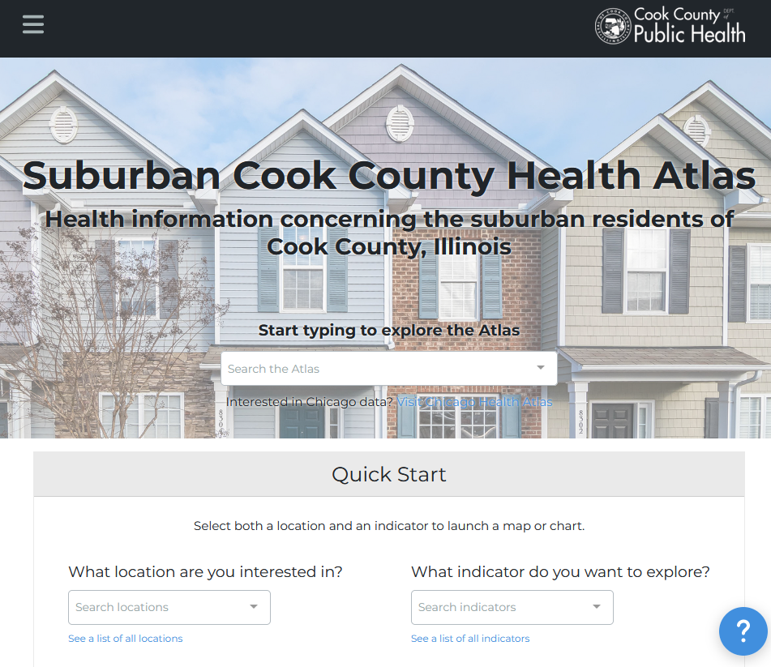
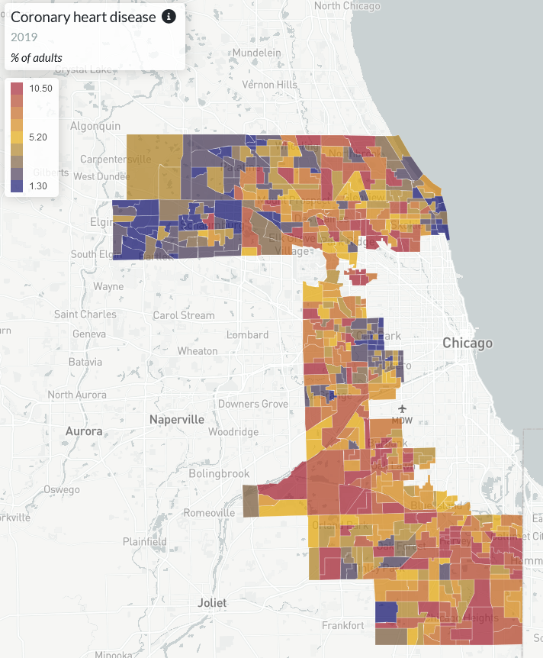


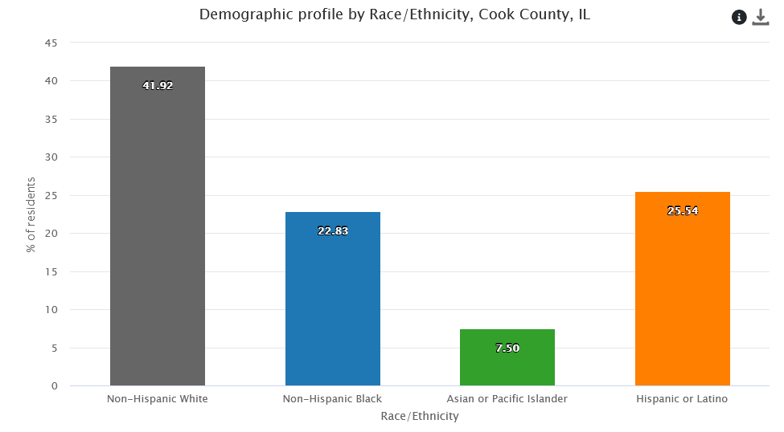
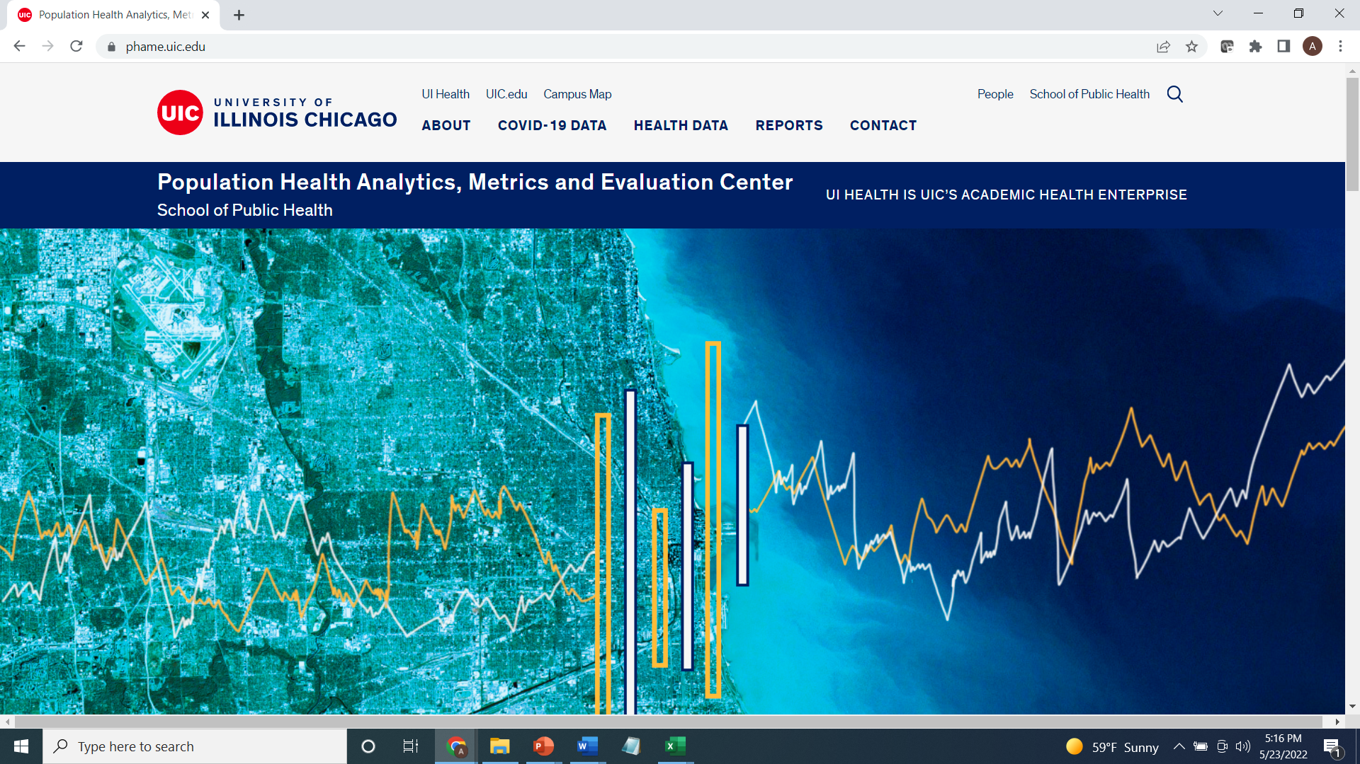
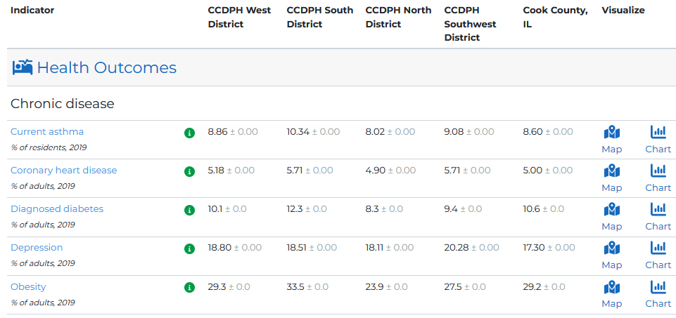
SUBURBAN COOK COUNTY HEALTH ATLAS
Using startup funds from CDC’s Health Equity Grant, CCDPH’s Epidemiology Unit is collaborating with UIC’s PHAME Center and Metopio to design and deploy an innovative, online atlas for exploring and sharing health information concerning the suburban residents of Cook County. The atlas allows stakeholders to examine, visualize and download health data using maps, charts and tables.
Notes:
The Cook County Department of Public Health’s Epidemiology Unit is leading an effort to design and deploy an online health atlas for suburban Cook County. We envision the atlas to be a platform for sharing a wealth of information to improve health awareness and decision-making. We are consulting with public health experts, working with other units within the department and reaching out to community members to identify what data to include.
In addition, the atlas contains several quality of life and risk indices related to public health that combine indicators across the six categories (e.g., social vulnerability index, index of concentration of extremes, neighborhood deprivation).

Slide 14


CCDPH PUBLIC HEALTH DATA SHARING ECOSYSTEM
The atlas will be an important component of CCDPH’s broader, multi-platform public health awareness,
data and code sharing ecosystem.
CCDPH STORYMAPS, DASHBOARDS AND REPORTS
SUBURBAN COOK COUNTY HEALTH ATLAS
Comprehensive, online health indicator data exploration and visualization tools designed for the broadest range of users
Immersive, topic-specific public health information presented using a combination of multimedia content including text and interactive maps
CCDPH GITHUB REPOSITORIES
CCDPH DATA REQUESTS
Delimited datasets, geographic feature layers and associated programming code made available for expert users
Online forms for partner agencies, researchers, community groups and the general public to request custom CCDPH datasets.
Notes:
The Cook County Department of Public Health’s Epidemiology Unit is leading an effort to design and deploy an online health atlas for suburban Cook County. We envision the atlas to be a platform for sharing a wealth of information to improve public health awareness and individual, agency decision-making.

Slide 15
GROWING OUR FOOD ACCESS-PUBLIC HEALTH PARTNERSHIP
OBJECTIVES
?
EPIDEMIOLOGY
?
Work as a group to identify shared concerns, capabilities, objectives and responsibilities.
CITIZEN SCIENCE
?
PUBLIC HEALTH
Idea 1
Idea 2
Idea 3
FOOD ACCESS
?
?
Notes:
Related outcome: Defining our partnership
Take turns completing information in this slide. What are the food access, other concerns of VeggieRx? Community residents? Define public health, epidemiology? How can we work together to achieve shared objectives?
Individualized exploration, data collection; tests methods and provides feedback; problem solving; identify questions, methods as through lens of a citizen; feedback; problem solving;; identify questions, methods ; study of community; as through lens of a citizen; problem identification;
Epidemiology; Interactions, examining patterns over time, monitoring

Slide 16

HEALTH ATLAS INDICATOR CATEGORIES
The health atlas will make available tools to explore and share public health information about suburban Cook County. Indicators on the health atlas will be organized into six information categories.
HEALTH OUTCOMES
DEMOGRAPHICS
Consequences, complications and other outcomes that result from disease (e.g., injury, hospitalization, death).
Population characteristics including community size, composition and structure (e.g., population, age, gender, race/ethnicity, migration).
HEALTH BEHAVIORS
?
SOCIOECONOMIC
The platform integrates several types of data
Individual activities that influence health (e.g., alcohol, drug and tobacco use; diet, physical activity, sleep).
Social and economic factors that can affect health (e.g., income, employment, education, segregation).
HEALTH CARE
PHYSICAL ENVIRONMENT
Systems and services for administering care (e.g., health screenings; primary, prenatal and dental care; clinics, hospitals, FQHCs).
Characteristics of the places where individuals where individuals live, learn, work, and play (e.g., parks, housing, air quality, water quality and transportation)
Notes:
Related outcome: Familiarize group with health atlas
What is the health atlas? The health atlas is designed to help CCDPH work toward achieving health equity for all people and communities of suburban Cook County. Our Epidemiology unit focuses on public health planning, promotion and prevention. Part of this involves advocating for and working with community stakeholders to assure the natural environmental and social conditions necessary to advance physical, mental and social well-being. Six categories of information.

Slide 17
health atlas FIRST YEAR DATA RELEASE TIMELINE
The atlas will be continually updated with the latest public health information for suburban Cook County. The rollout of the data over the first year will proceed in four phases. With each phase, the Epi Unit will reach out to other CCDPH units, the county and community-based contacts for data requests and feedback.
01
02
03
04
PHASE ONE (June 2022)
PHASE TWO
(August 2022)
PHASE THREE
(October 2022)
PHASE FOUR
(April 2023)
Select indicators from CCDPH’s latest Community Health Status Assessment; Social Vulnerability; Communicable disease prevalence; Opioid deaths
2013 to 2020 birth and death rates; 2020 Youth Risk Behavioral Survey data; Environmental justice screening data
2018 to 2020 hospitalization inpatient and outpatient data
2022 Suburban Cook County Health Survey data; 2022 Youth Risk Behavioral Survey data

Slide 18
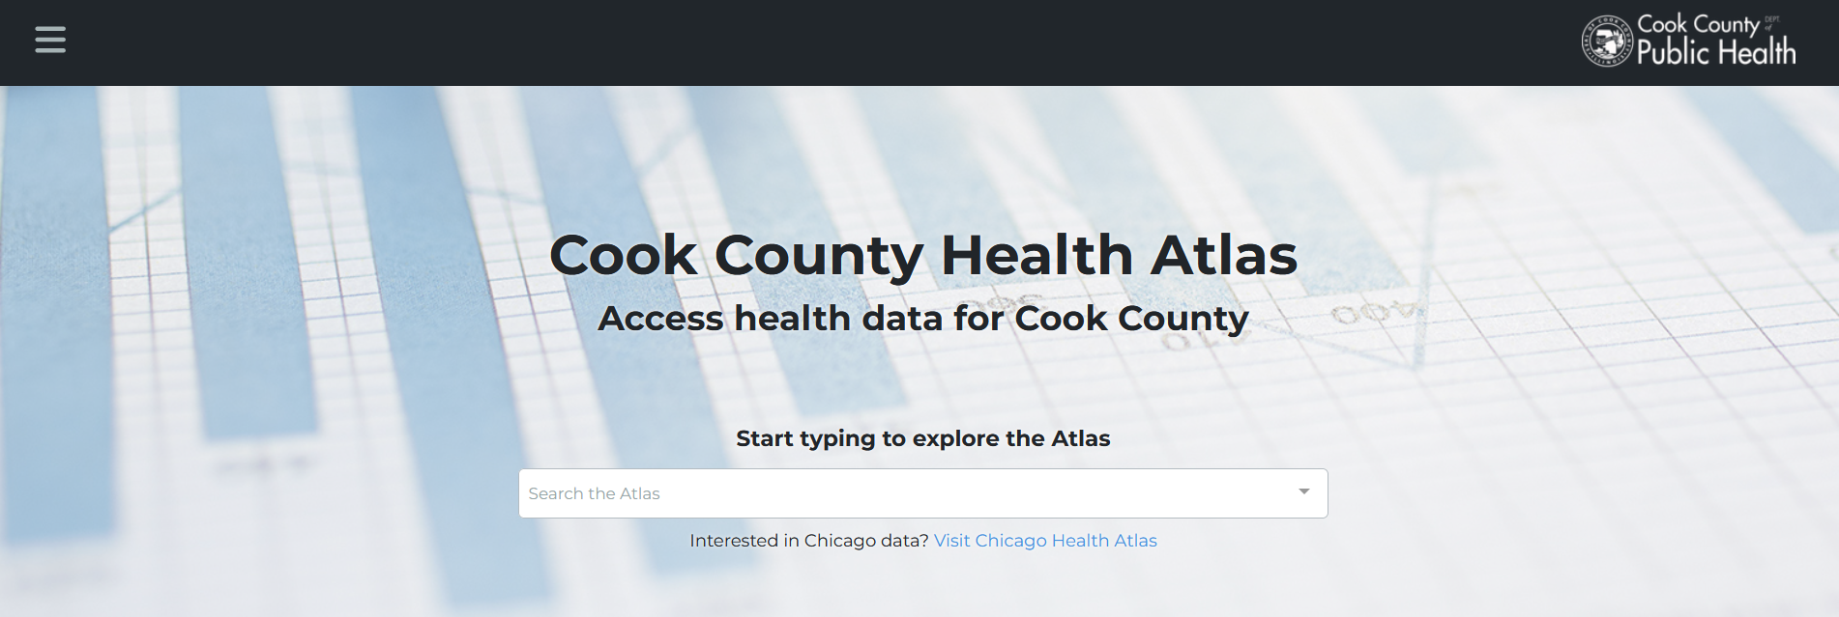
1
2
3
CHOOSE AN ACTIVITY THEME
HEALTH OUTCOMES
DEMOGRAPHICS
SOCIAL DETERMINANTS
Explore community patterns of disease and mortality
Explore neighborhood population characteristics including age, race and ethnicity
Explore indicators of food access and social vulnerability

Slide 19



CO-DESIGNING PUBLIC HEALTH DATA ACCESS & AWARENESS
CCDPH aims to work with VeggieRx to co-design the platform to improve its functionality and usability
(e.g., adding and enriching datasets, tools and documentation)
What did you find interesting with the health atlas?
What did you find confusing about the health atlas?
What types of data or tools could inform VeggieRx programs?
How could CCDPH’s Epi Unit further assist VeggieRx with the atlas?
Notes:
1. interesting?

Slide 20

NEXT STEPS
Identify potential uses &
enhancements
1
Work together to identify ways in which VeggieRx could use and/or improve the health atlas.
2
Implement changes
If needed, upload, edit and/or enhance datasets, tools and documentation on the platform.
3
Formalize use cases
Develop strategies and/or workflows to help VeggieRx utilize enhancements to the health atlas.

Slide 21
Thank You Questions or comments? Please email christopher.smith@cookcountyhealth.org
Notes:
CCDPH is one of 107 grant recipients.

